Slide 1

Solution Design 3: Technical Architecture
Notes:
Speaker Notes:
Introduce yourself (name, major, maybe a fun fact!)
In this workshop, we’ll be discussing and practicing skills around basic technical architecture.

Slide 2

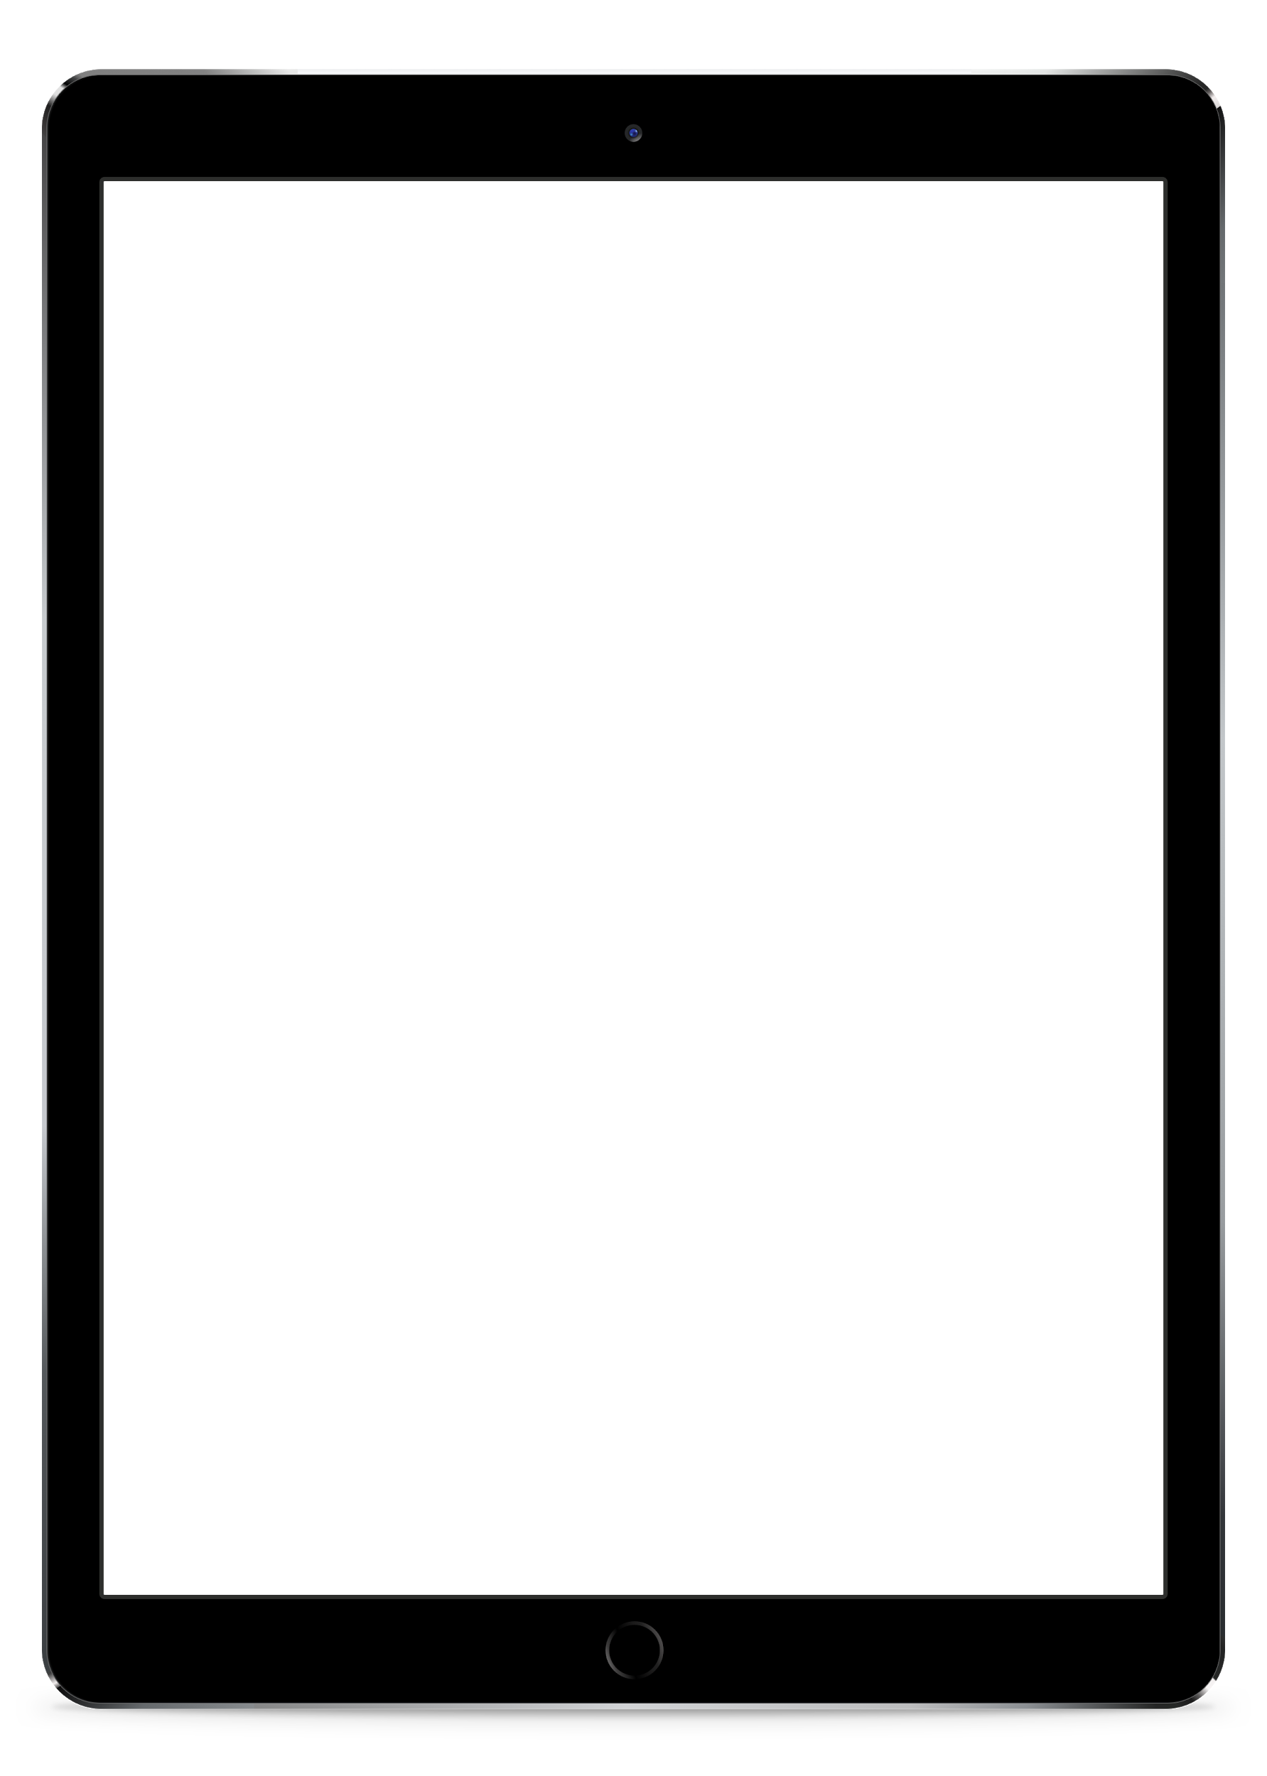
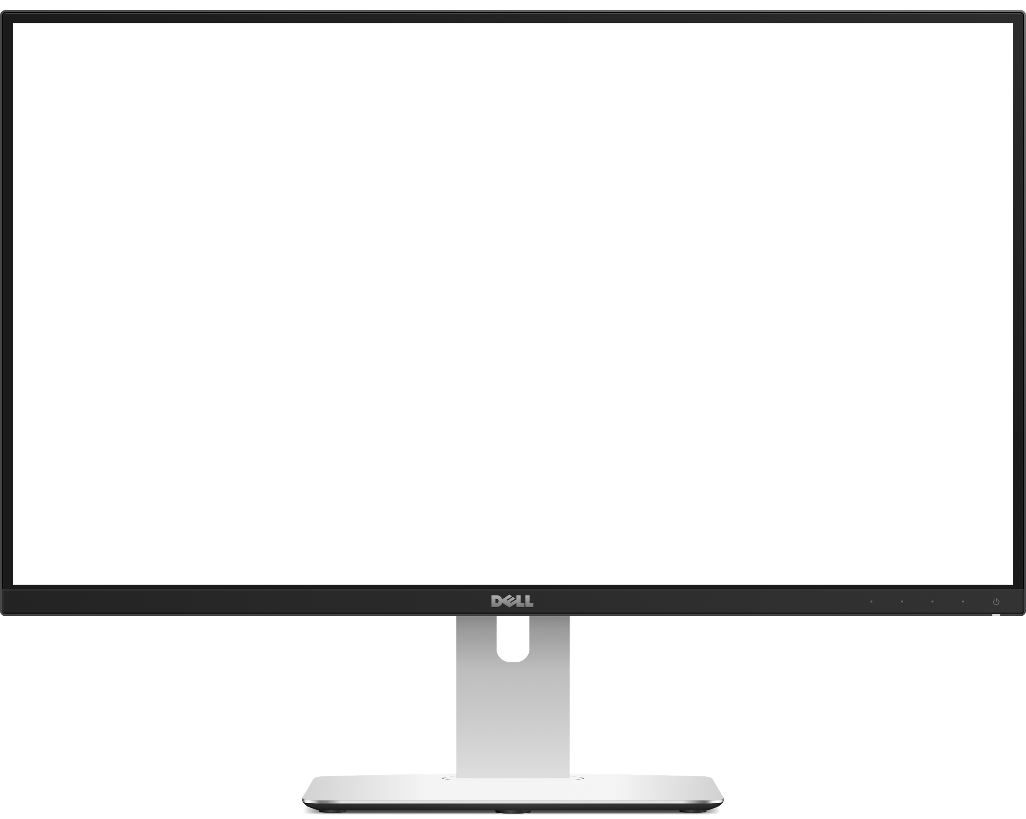
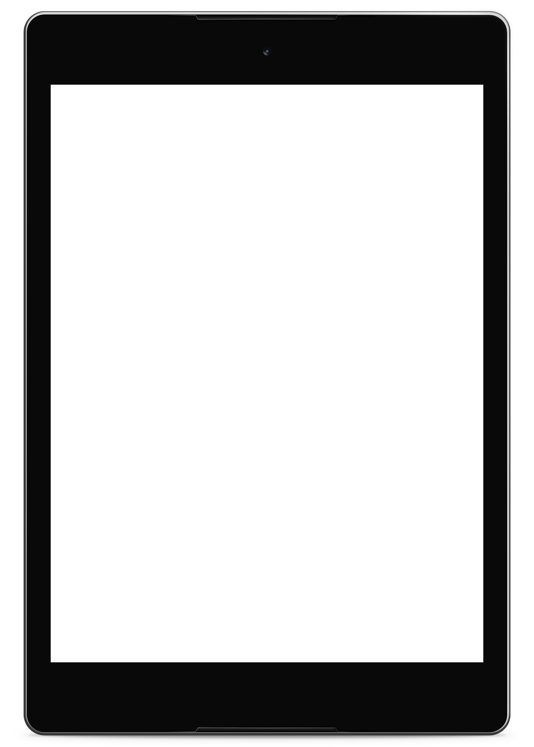

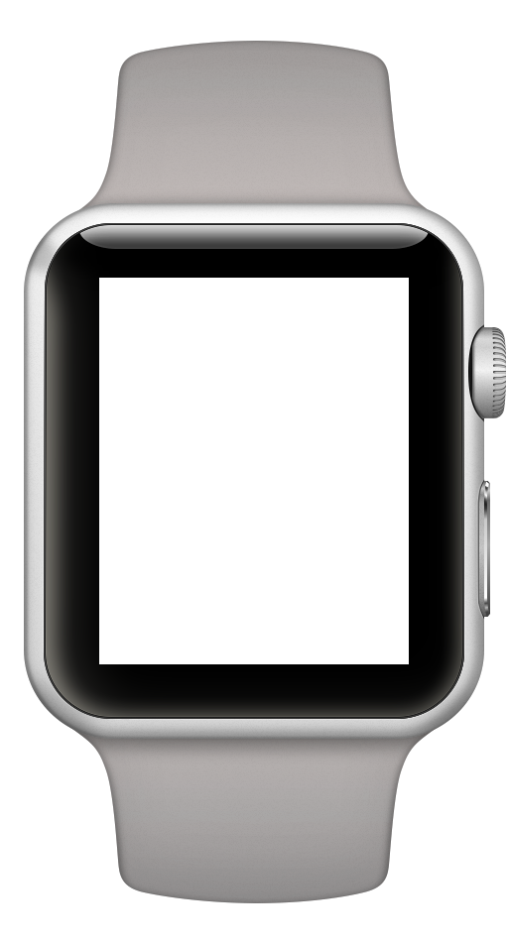
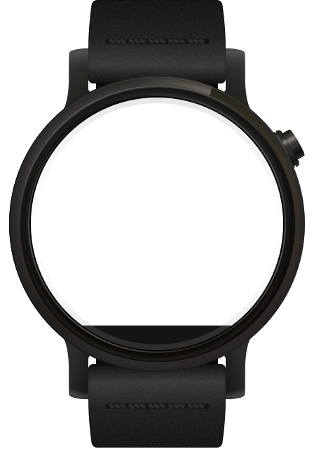
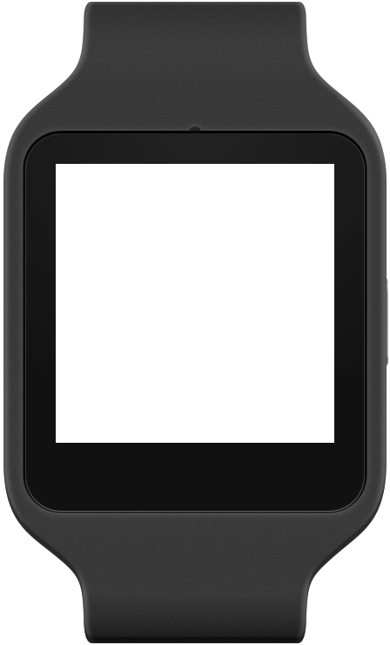
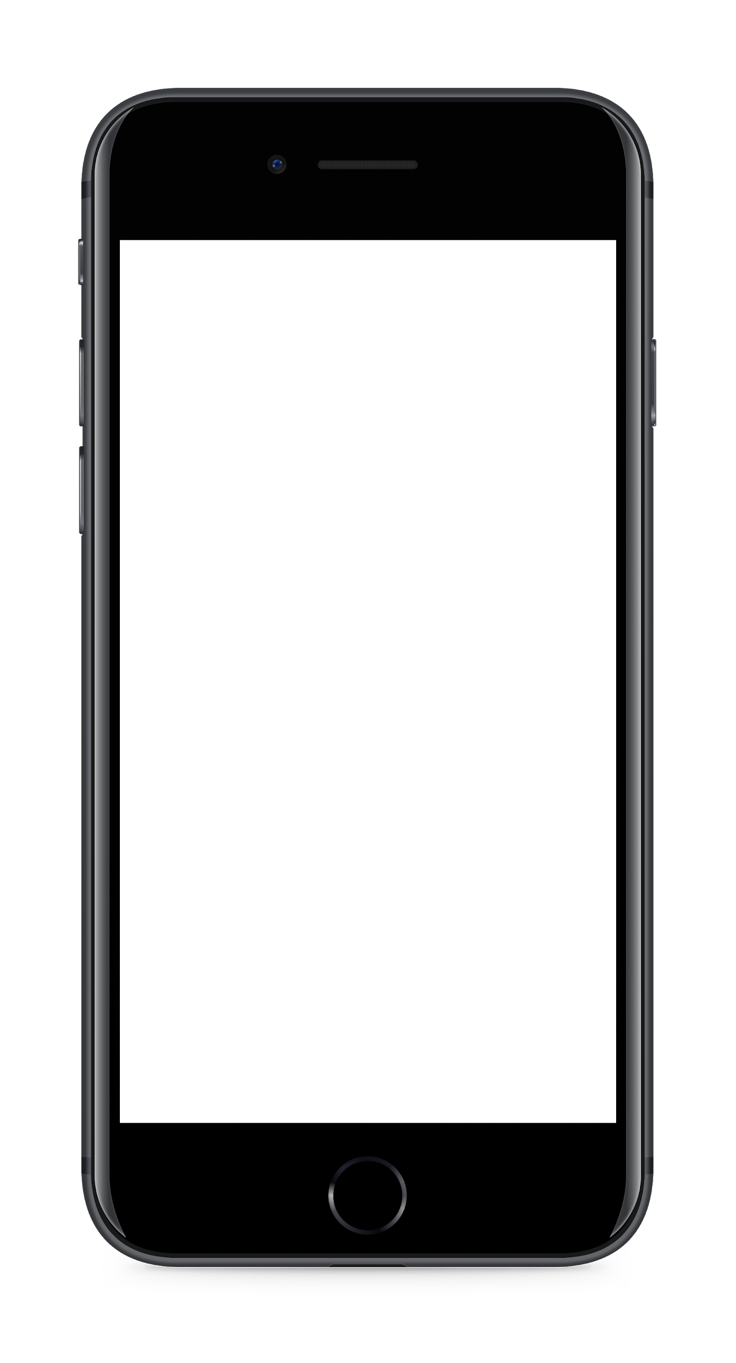
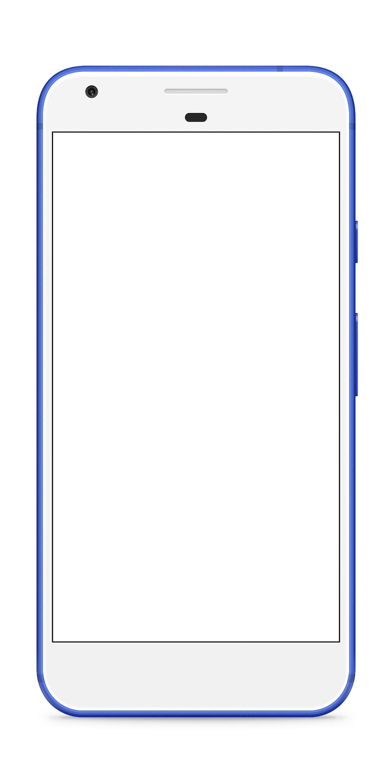
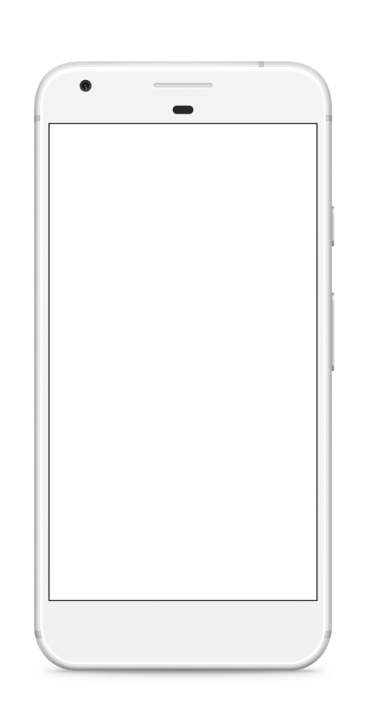
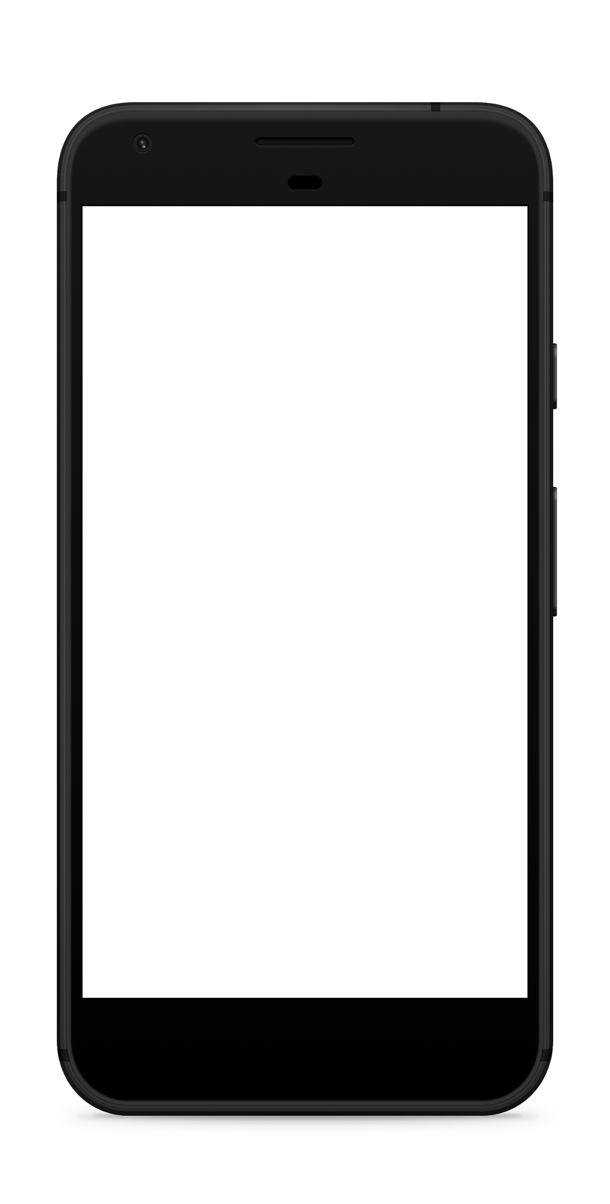
Notes:
Speaker Notes:
Speaker Notes: When people think of apps, they usually think about mobile devices, laptop or desktop computers, tablets or even smart-watches. We think about mobile applications written in Kotlin, Java, or Swift or maybe a cross-platform framework like Flutter. We think about HTML, CSS, and Javascript. But this is only a part of what makes our apps work.

Slide 3

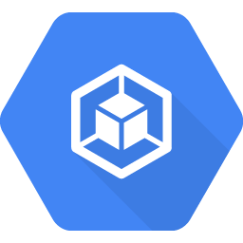
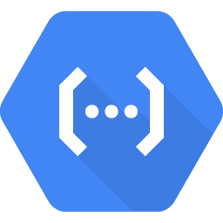
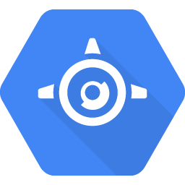
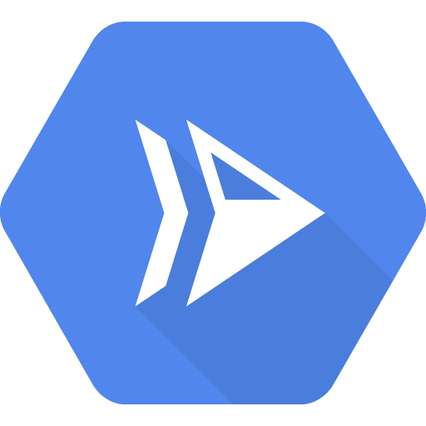

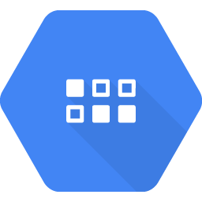
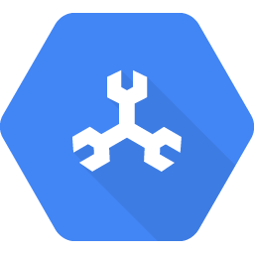

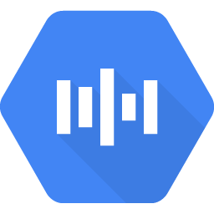
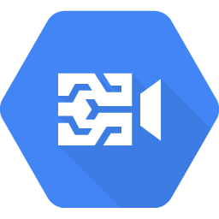
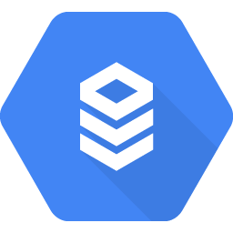
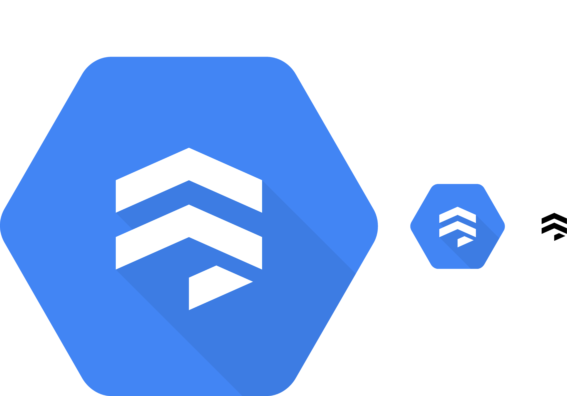
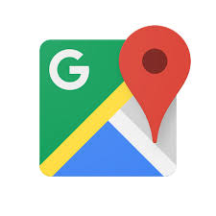

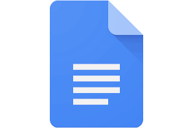
Back-end (server)
Running Code
Front-end (client)
...
Data Storage
Other Services
...
...
Notes:
Speaker Notes:
In reality, apps have much more than that.
In addition to the front-end, or client, there’s an entire back-end to most applications.
Most back-ends even have multiple parts, which can mostly be bucketed into “Running Code,” “Data Storage,” and “Other Services.”

Slide 4
Back-end (server)
example:
photo-sharing app
Running Code
Front-end (client)
Data Storage
Other Services
Notes:
Speaker Notes:
Let’s walk through an example. Let’s say we want to build a photo-sharing application.

Slide 5
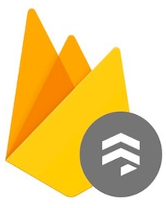
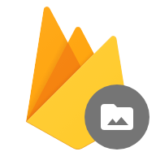
Back-end (server)
example:
photo-sharing app
Running Code
Front-end (client)
Cloud Functions
Data Storage
Other Services
Web
Firebase Firestore
Firebase Storage
Notes:
Speaker notes:
We can start by defining the client. In this case, we want it to be a web application.
Then, we need somewhere to host our back-end and run our code. For that, we choose Cloud Functions. Cloud functions is a tool which allows developers to write a function in Python, Node (javascript), or Go, and trigger it on HTTP requests. It also handles all of the scaling for us, so it’s really good for beginners looking to develop web applications.
We also need somewhere to store our user information like usernames, etc. For that, we can use Firebase Firestore. This is a NoSQL database which is also fully managed -- meaning that it handles all of the scaling for you.
Lastly, we need to store our photos somewhere. For that, we’ll use Firebase Storage. This is Firebase’s file storage system, allowing us to store our photos on the cloud.
That’s it -- we have our photo app!

Slide 6
Back-end (server)
example:
photo-sharing app
Running Code
Front-end (client)
Cloud Functions
Data Storage
Other Services
Web
Firebase Firestore
Firebase Storage
Cloud Vision API
Notes:
Speaker notes:
Let’s say we wanted to add photo-searching functionality like in Google Photos. To do so, we can use the Cloud Vision API. The Cloud Vision API uses advanced machine learning, and it’ll allow us to automatically create tags for all of the images, letting us search through all of our photos with key terms.

Slide 7
Back-end (server)
example:
photo-sharing app
Running Code
Django (Python)
Express.js (Node.js)
Ruby on Rails (Ruby)
Spring (Java)
...
Front-end (client)
w/
App Engine Standard
Data Storage
Other Services
Web
Firebase Firestore
Firebase Storage
Cloud Vision API
Notes:
Speaker notes:
What if we have a bit more experience programming and want to use a popular web framework like Django, Express.js, Ruby on Rails, or Spring? In that case, we can use App Engine Standard. This is Google Cloud’s Platform-as-a-Service tool, which allows you to upload your code and it handles everything else for you!

Slide 8
Back-end (server)
example:
photo-sharing app
Running Code
Django (Python)
Express.js (Node.js)
Ruby on Rails (Ruby)
Spring (Java)
...
Front-end (client)
w/
App Engine Flexible
Data Storage
Other Services
Web
Firebase Firestore
Firebase Storage
Cloud Vision API
Notes:
Speaker notes:
Unfortunately, App Engine Standard doesn’t support websockets. No worries, because Google Cloud also has App Engine Flexible. App Engine Flexible is different from App Engine Standard in a few ways. It supports websockets, but it’s also much better at handling relatively sustained levels of traffic. App Engine Standard, though, is much better at handling spikes of traffic. App Engine Standard also takes under 60 seconds to deploy your code, while the Flexible environment takes between 5-10 minutes.

Slide 9
Back-end (server)
example:
photo-sharing app
Running Code
Django (Python)
Express.js (Node.js)
Ruby on Rails (Ruby)
Spring (Java)
...
Front-end (client)
w/
App Engine Flexible
Data Storage
Other Services
Firebase Firestore
Firebase Storage
Cloud Vision API
Notes:
Speaker notes:
Lastly, we might want to add different types of clients that each interact with the backend, giving our users access to their photos on all of their devices.

Slide 10
How can we do this?
Notes:
Speaker notes:
Like anything else, this is much easier said than done. So, how can we make these decisions in practice?

Slide 11
Considerations
Research
Design
How can we do this?
Notes:
Speaker notes:
We’ve broken it down into three, pretty simple, steps. First, we make a list of all of our considerations, or constraints. Then, we do research and choose the tools that make sense with our considerations. Lastly, we decide how these tools will communicate with each other.

Slide 12
What does my application require?
How many people are on my team?
How experienced are we?
What languages / tech are we comfortable with?
What is our budget?
What is our timeline?
How accelerated is our timeline?
How much load does this service have to provide?
What security considerations must we make?
What compliance considerations must we make?
What technologies do we have to integrate with?
…
step 1: considerations
Notes:
Speaker notes:
First, we make a list of considerations. Make a list of everything that might impact how this product is built -- that means everything from how the user will use it to what your technical experience is.
Here is a list of some considerations that might be useful.

Slide 13
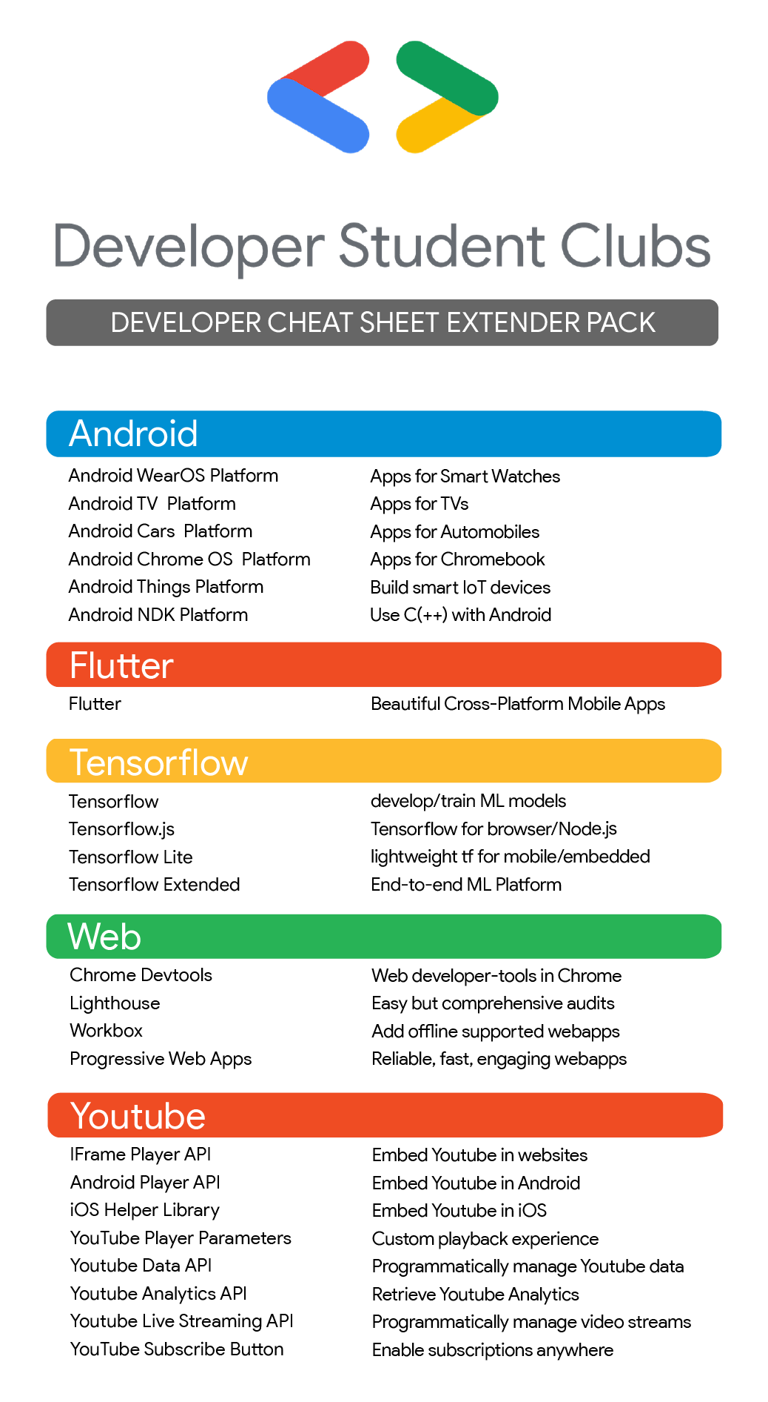
bit.ly/google-cloud-4-words
step 2: research
Notes:
Speaker notes:
Next, you should do research and make a list of all tools you may use. At this link, bit.ly/google-cloud-4-words, you’ll find a popular tool called the “Google Cloud Developer Cheat Sheet,” which describes every Google Cloud tool in four words or less. We’ve created an extension of this Cheat Sheet just for you, which outlines all of Google’s developer tools which you’re free to use.

Slide 14
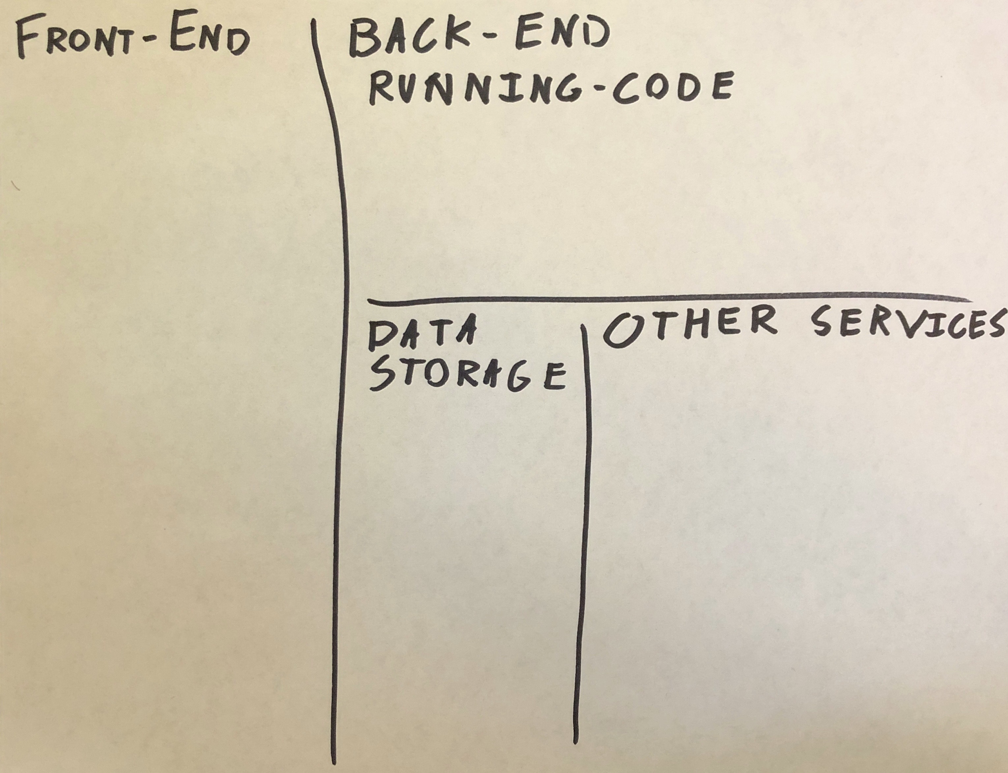
step 3: tech design
Notes:
Speaker notes:
The last step is to actually design the tech. For this step, take out a piece of paper and a marker and divide it like so. In each part of the grid, you’ll write what tools you’ll use and what purpose they’ll serve.

Slide 15
Back-end (server)
workshop:
e-commerce ,
food-delivery,
productivity app,
(insert your idea here)
Running Code
Front-end (client)
Data Storage
Other Services
Notes:
Speaker notes:
Now, you need to choose an idea. You might have already come with an idea -- perhaps the idea you’re working on for the Global Solutions Challenge. We also have three example ideas you can choose from.

Slide 16
Go!
Notes:
Speaker notes:
If you’ve come here in your groups, you can stay together. Otherwise, I’ll split you up. Once you’re split up, choose an idea, and go! In 30-45 mins, we’ll come back together and each team will have 1 minute to present their work

Slide 17
Present!

